Slide 1

SMART DIALYSIS MONITORING SYSTEM WITH AUTOMATIC CUT-OFF FACILITY
BIOMEDICAL DEPARTMENT
Submitted by
Naeem Abdul Salam 724018121020
Mohammed Fasil KV 724018121011
Mohammed Ashiq PP 724018121010
Mohamed Asif 724018121027
Guided by
Ms. K Rajarajeswari
Assistant Professor

Slide 2
CONTENTS
Introduction
Abstract
Existing System
Problem Statement
Proposed System
Block Diagram
Hardware Components
Hardware Setup
Conclusion
Result and Output
Reference

Slide 3
INTRODUCTION
As we all know Haemodialysis is the process of purification of a persons blood whose kidneys are not working normally. The smart Internet concept (IoT) which consists of connecting everything surrounding us to Internet and making it responsible of arranging and exchanging data.
The main objective of IoT-based smart monitoring and controlling systems is to ensure a continuous control of all the crucial patient parameters such as the body temperature, the blood pressure, the volume of blood flow during dialysis by use of a single system.

Slide 4
ABSTRACT
The main motto of this project is to remotely monitor the dialysis process of the patient who is in need of this process. Due to the pandemic conditions like Covid-19, there exists a main drawback of tracking of patients as it involves one to one contact between patient and doctors. Moreover when the doctor needs to be closely watch the patient dialysis process, it forms nightmare to do so and hence we proposed this project in order to remotely monitor the patient dialysis process through IOT application. Through this application, the patient blood temperature, the volume of blood flows through the inlet chamber of dialysis, blood outflow from the dialysis chamber and finally the weight is monitored. Also the corresponding parameters are monitored locally though LCD display (16x2) for the physical monitoring of the dialysis process.

Slide 5
EXISTING SYSTEM
IoT based system for continuous monitoring of crucial patient parameters like temperature, blood pressure, glycemic index and SpO2. And these parameters are fed to the cloud for reference.

Slide 6
PROBLEM STATEMENT
• Absence of the air bubble detection system.
• Doesn’t have SMS notification and triggering alert.
• We can’t monitor from remote location.
• Automatic Cut-Off facility is unavailable.

Slide 7
PROPOSED SYSTEM
We are implementing automatic cut-off facility to the dialysis system.
Air Bubble detection system is added.
Our system enables the healthcare providers to analyze and act from remote location.
SMS alert and buzzer alert is added.

Slide 8
BLOCK DIAGRAM
AC
MAINS
STEP DOWN
TRANSFORMER
BRIDGE
RECTIFIER
16X2 LCD DISPLAY
CAPACITIVE FILTER
BLOOD IN FLOW SENSOR
TEMPERATURE SENSOR
MICRO-CONTROLLER
UNIT (ARDUINO UNO)
VOLTAGE REGULATOR
BLOOD OUT FLOW SENSOR
NPN DRIVER
SIMCOM GSM MODEM
AIR BUBBLE DETECTOR
BUZZER
EMERGENCY CUTOFF RELAY
SMS AND CALL ALERT

Slide 9
HARDWARE COMPONENTS
Arduino Uno
Input components
A) LM35
B) Flow sensor
C) I-R sensor
3. Output components
A) 16x2 LCD
B) Buzzer
C) Relay
D) GSM Module

Slide 10
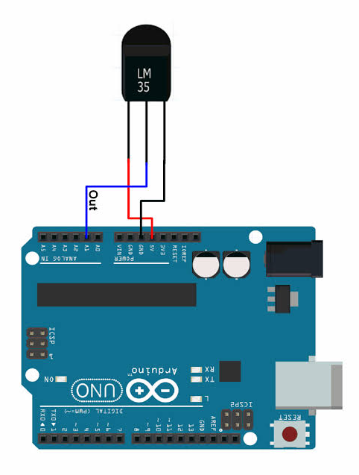
TEMPERATURE SENSOR
• LM35 is one kind of commonly used temperature sensor that can be used to measure temperature with an electrical o/p comparative to the temperature (in °C)
•The blood temperature needs to be between 35.5 to 37 degrees.
So the LM35 helps in detecting the temperature variations during dialysis.

Slide 11
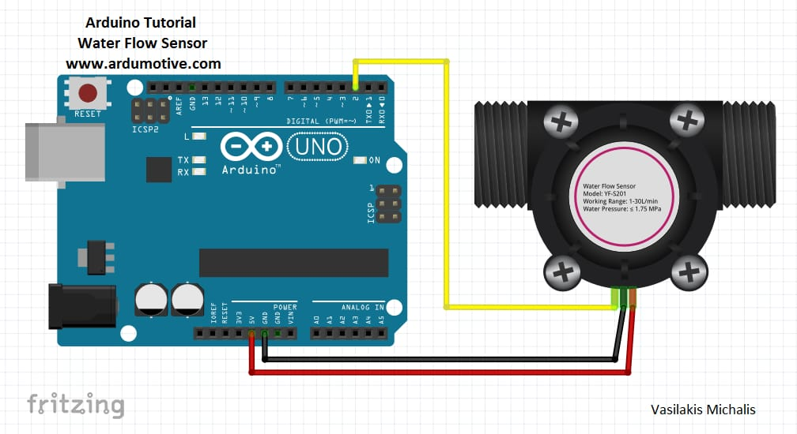
FLOW SENSOR
•These sensors allow safety-critical monitoring of liquid level, flow and pressure in the blood circulation.
Flow Rate Range: 0.1~3L/min.
Blood flow Range: 0.3~0.5L/min.

Slide 12
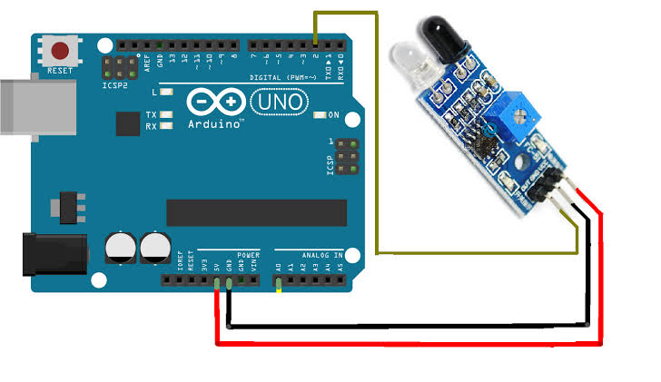
I-R SENSOR
• The infrared LED emits Infrared signals at certain frequency and when an obstacle appears on the line of infrared light, it is reflected back by the obstacle which is sensed by the receiver.
• So the sensor can detect the air bubble presence during the dialysis process by the difference in the reflected light.

Slide 13
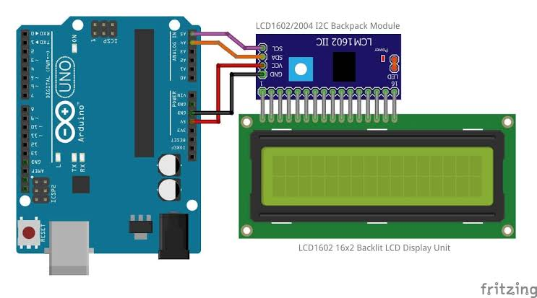
16x2 LCD
• An LCD is an electronic display module that uses liquid crystal to produce a visible image.
• Its shows the output values from sensors; LM35, I-R sensor, Flow sensor.

Slide 14
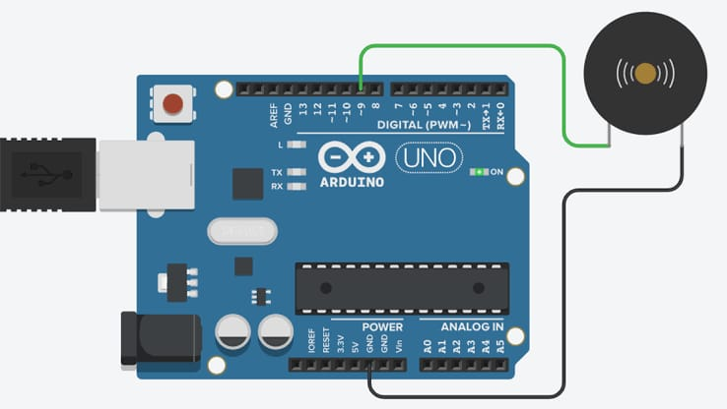
BUZZER
Apply an oscillating voltage to make a noise.
The buzzer case supports the piezo element and has resonant cavity for sound.

Slide 15
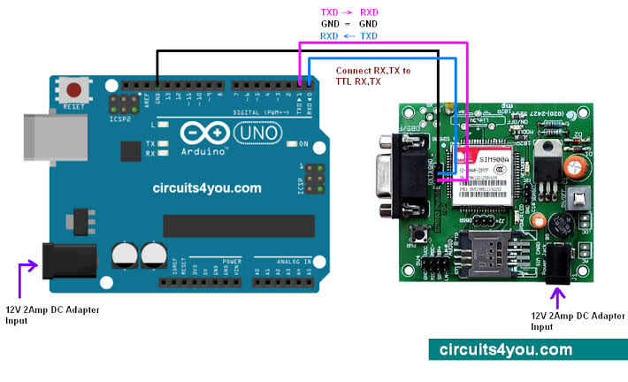
GSM MODULE
This GSM Modem can work with any GSM network operator SIM card just like a mobile phone with its own unique phone number.
Sensor Monitoring
SMS based Remote Control and Alerts
GPRS Mode Remote Data logging.

Slide 16
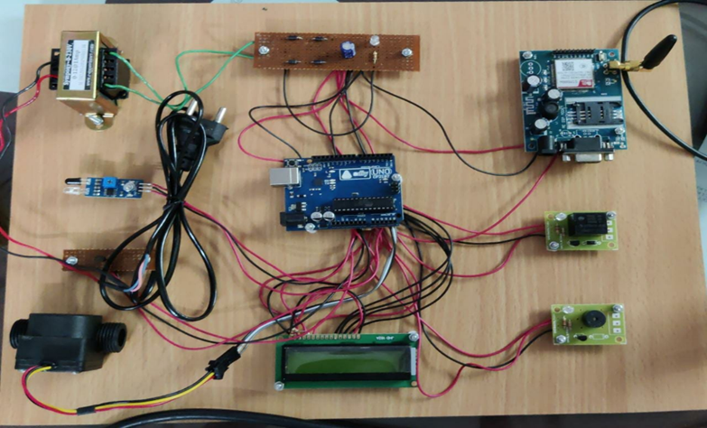
HARDWARE SETUP

Slide 17
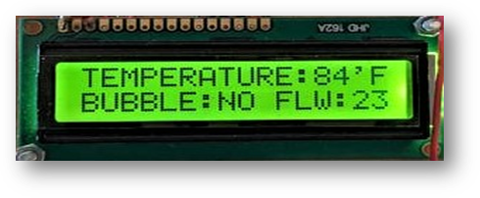
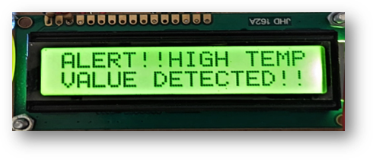
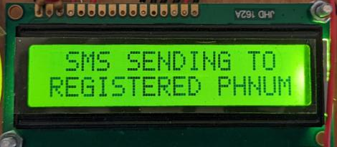
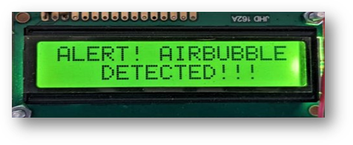
RESULT AND OUTPUT
A) Normal Dialysis Condition
B) High Temperature Detected
C) Air bubble Detected
D) Sending SMS To Registered Phone Number

Slide 18
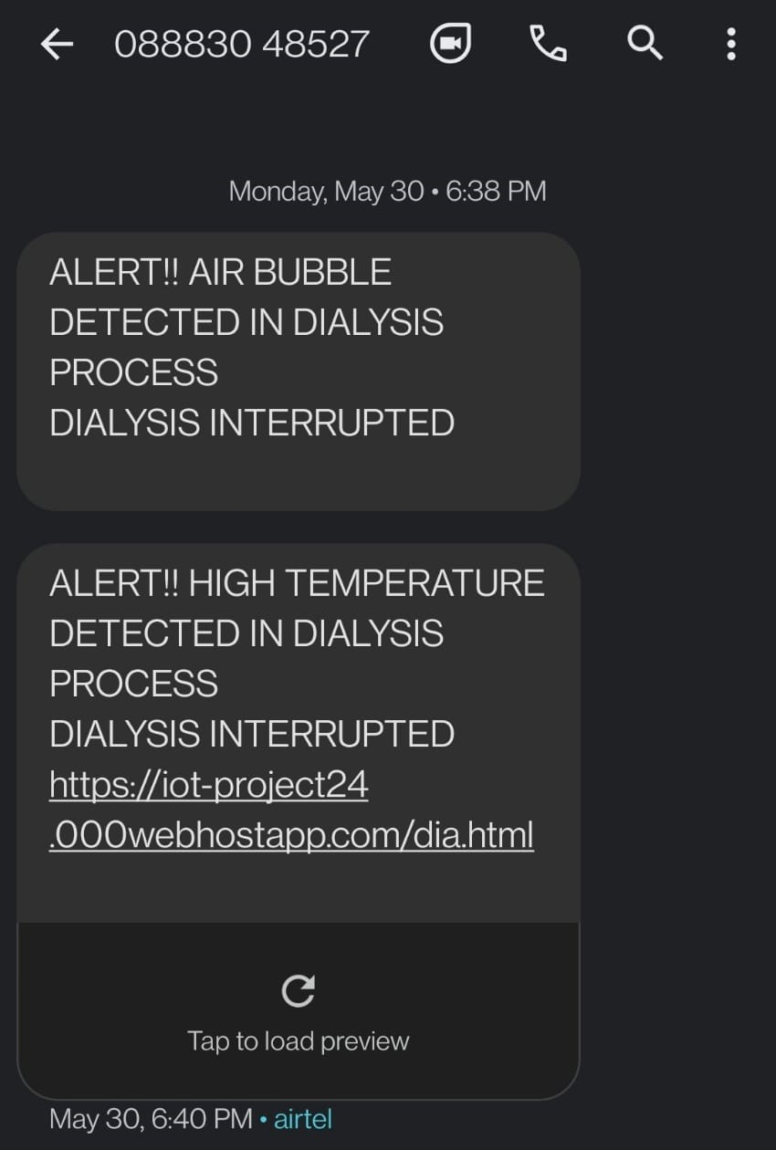
SMS ALERT RECEIVED IN THE REGISTERD PHONE NUMBER

Slide 19
CONCLUSION
By using this project we can monitor the patients dialysis parameters like temperature and blood flow continuously and it will be logged in to the cloud platform.
The system which have been developed in this research can make development of dialysis procedure risk free. Also we can make the procedure contactless between patients and healthcare providers.
Overall, the application developed in Android device can functions properly in monitoring the whole dialysis procedure and received SMS notification when abnormality is detected.

Slide 20
REFERENCE
S. M. R. Islam, D. Kwak, M. H. Kabir, M. Hossain and K. Kwak, "TheInternet of Things for Health Care: A Comprehensive Survey," in IEEEAccess, vol. 3, pp. 678-708, 2015.
V. Pardeshi, S. Sagar, S. Murmurwar and P. Hage,"Health monitoringsystems using loT and Raspberry Pi - A review," 2017 InternationalConference on Innovative Mechanisms for Industry Applications(ICIMIA), Bangalore, 2017, pp. 134-137.
Puthal, B.D, Malik, N., Mohanty, S.P., Kougianos, E. & Yang. C"The Blockchain as a Decentralized Security Framework,p. S-112008.
Islam M. S., Islam M. T., Almutairi A. F., Beng G. K., Misran N., andAmin N., "Moni oring of the human body signal through the Internetof Things (loT) based LoRa wireless network system," AppliedSciences, vol. 9, no. 9, 2019.
Dauwed M. A., Yahaya J., Mansor Z., and Hamdan A. R."Determinants of internet of things services utilization in healthinformation exchange," Journal of Engineering and Applied Sciences,vol. 13, no. 24, pp. 10490-10501, 2018.

